Slide 1



Introduction to NoSQL Database

Slide 2

Objectives
By the end of the session, you will be able to:
Explain different types of database categories.
Explain NoSQL database and how it is beneficial.
Comparison of RDBMS with NoSQL.

Slide 3

Objectives
Describe different type of NoSQL.
Discuss NoSQL schema..
Overview of MongoDB Compass.

Slide 4

Database Introduction

Slide 5

What is Database ?
A Database is a collection of Information.
Data in a Database is organized so that it can be easily accessed, processed and updated.
Database is important as it manages information efficiently for users to perform various tasks.

Slide 6
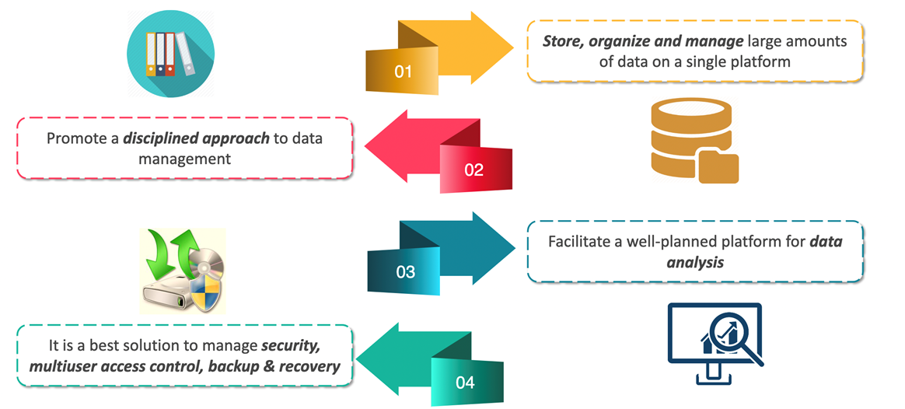
Why should we use a database?

Slide 7
RDBMS vs. NoSQL Databases

Slide 8
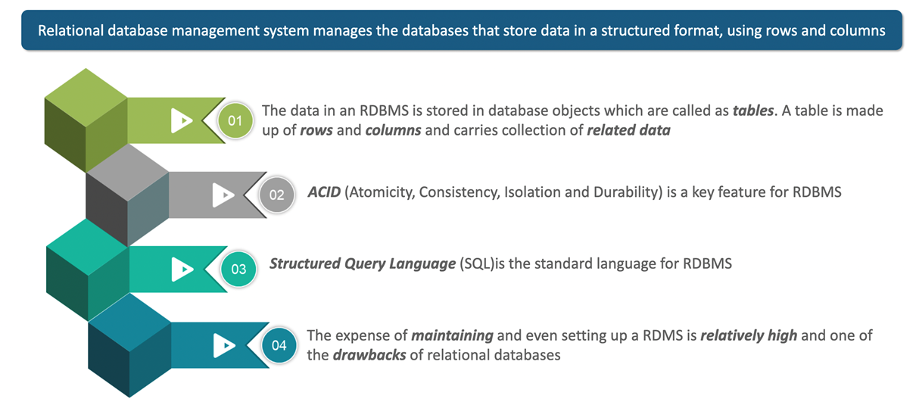
Relational Database Management System

Slide 9
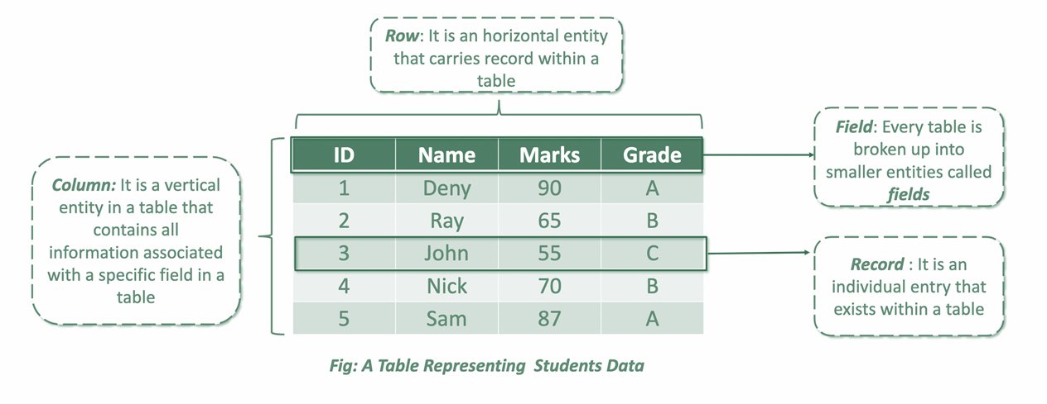
Example of Relational Database

Slide 10
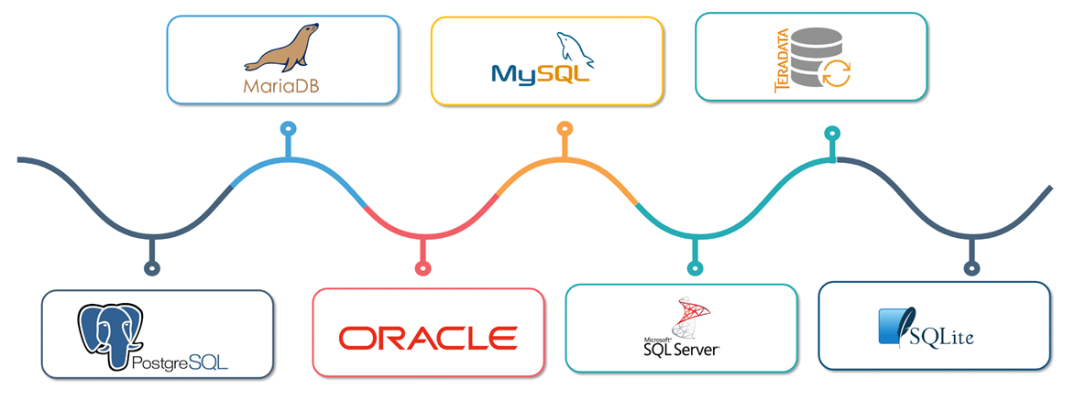
Relational Databases

Slide 11
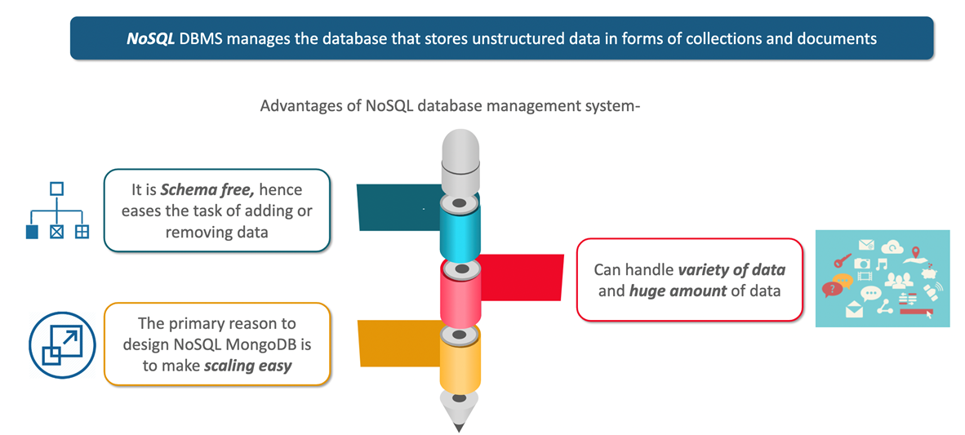
NoSQL Database Management System

Slide 12
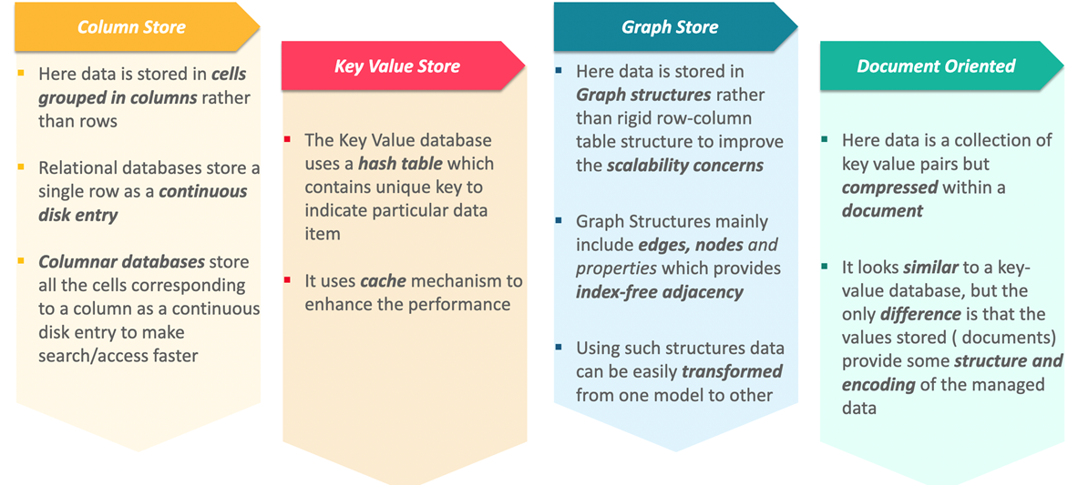
Categories of NoSQL Databases

Slide 13
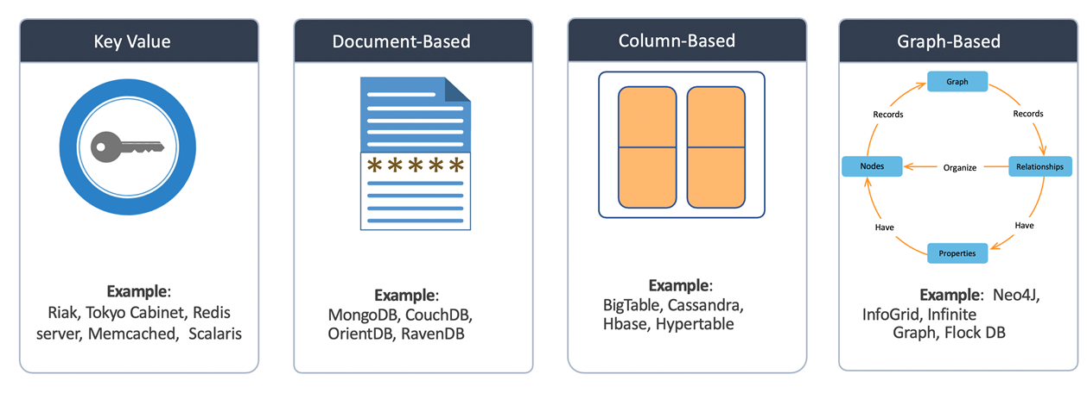
Types of NoSQL Databases

Slide 14
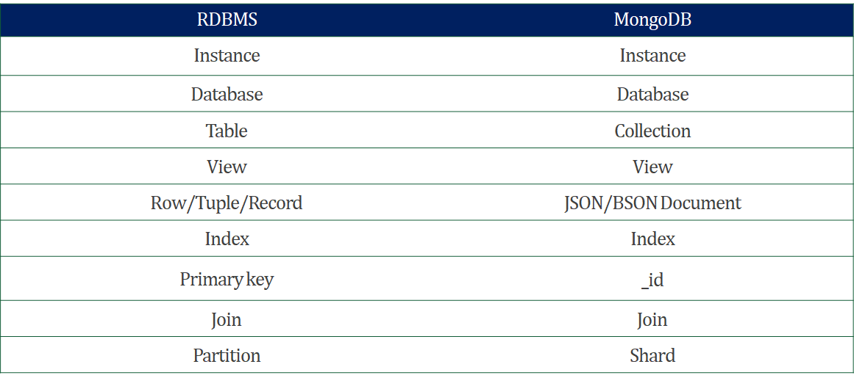
SQL to MongoDB Mapping

Slide 15
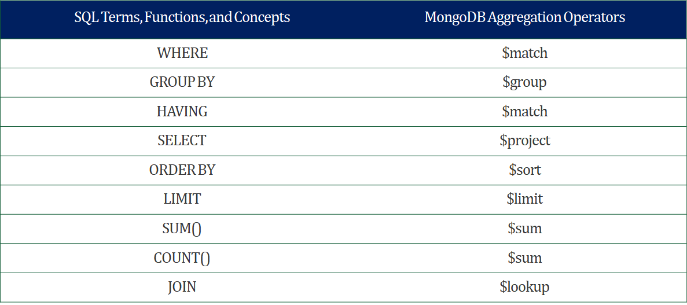
SQL to MongoDB Mapping

Slide 16
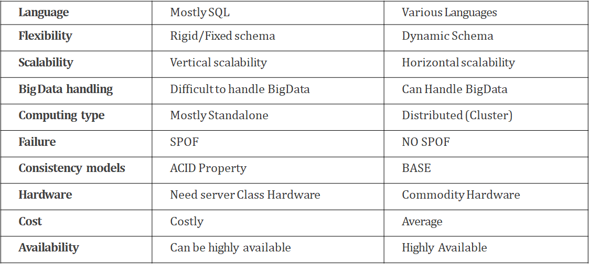
DIFFERENCE BETWEEN RDBMS AND NOSQL DATABASES

Slide 17
Introduction to MongoDB

Slide 18

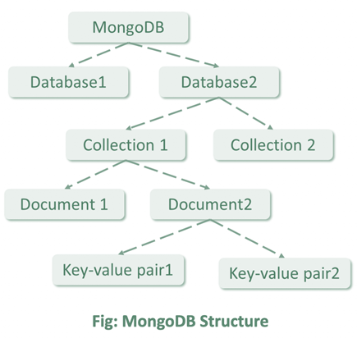
MongoDB Introduction
MongoDB is an open-source database management system (DBMS) that uses a document-oriented database model which supports various forms of data.
It holds a set of collections and stores data as document.
MongoDB supports BSON (by JSON) data structure and complex query language.
The BSON document storage is binary representation of JSON-like documents. It gives high-speed admittance to store mass data.

Slide 19
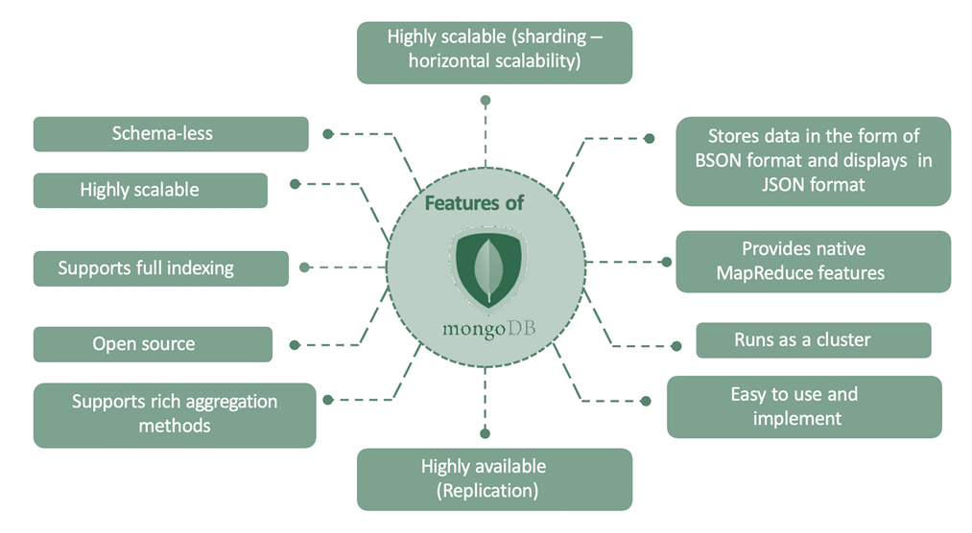
Features of MongoDB

Slide 20
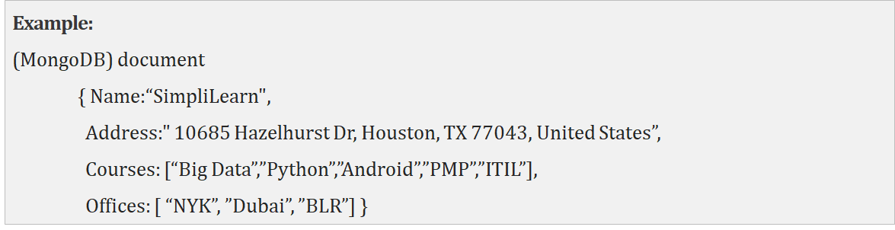
DOCUMENT DATABASE
Document Database stores and retrieves various documents in JSON, XML, and BSON.
Examples of Document databases are MongoDB and Apache CouchDB.

Slide 21

Companies using MongoDB

Slide 22
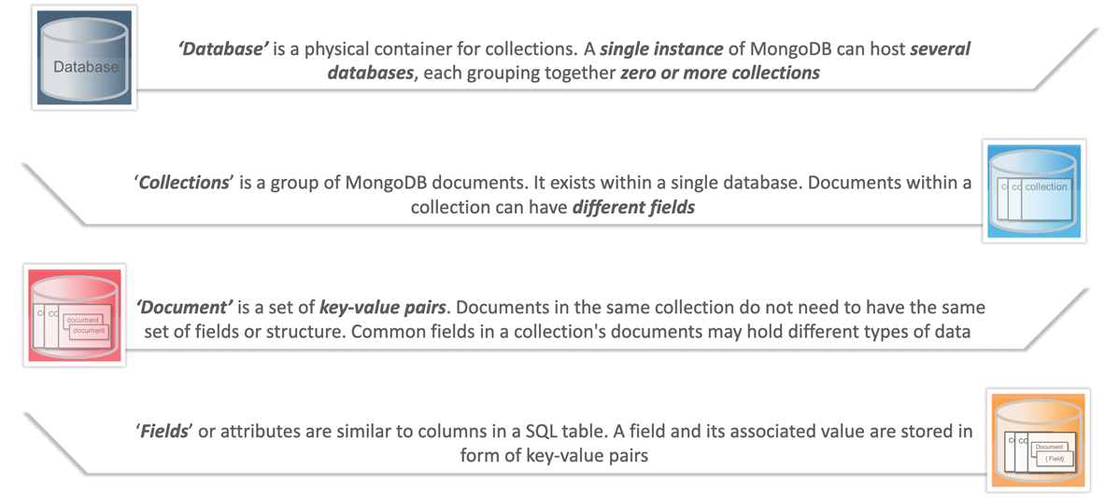
MongoDB Terminologies

Slide 23
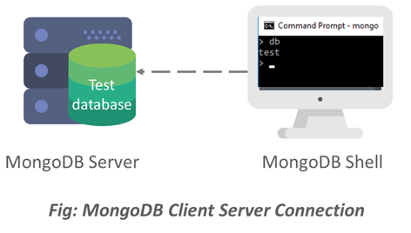
MongoDB Client-Server Connection
MongoDB contains powerful tool called the mongo shell, which provides built in support for administering MongoDB instances and manipulating data using the MongoDB query language.
On installing MongoDB you get two parameters:
MongoDB server and shell.
Mongo Shell connects to the test database on a MongoDB server.
Then it assigns the database connections to the global variable ‘db’.
This variable is the primary access point to your MongoDB server.
The command used to start server is mongod and to establish a connection is mongo.

Slide 24
MongoDB Compass

Slide 25
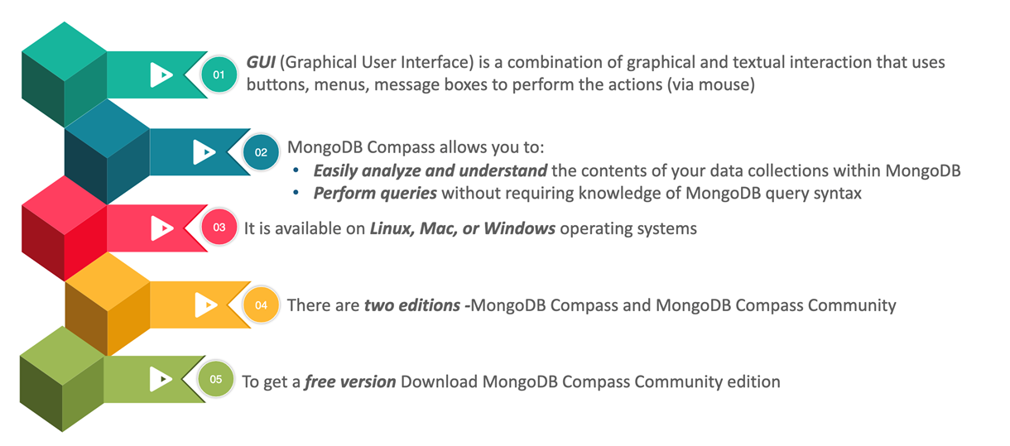
MongoDB Compass

Slide 26
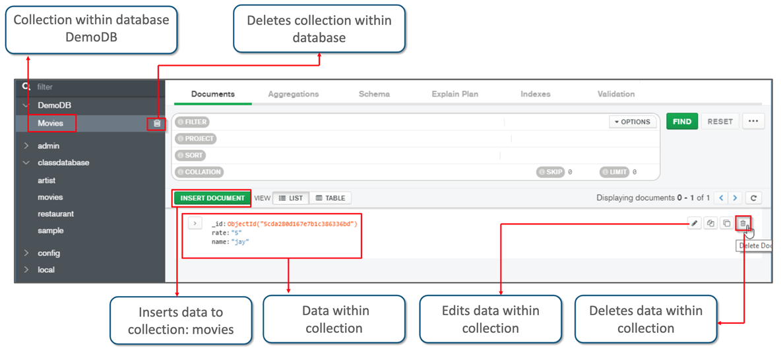
MongoDB Compass Dashboard

Slide 27
Thank You!

